Slide 1


Slide 2


BLOOD RELATION

Slide 3
BLOOD RELATION
Important Blood Relations
1. Mother’s (or) Father’s Daughter – Sister 2. Daughter’s husband – Son in law 3. Mother’s brother – Maternal Uncle 4. Mother’s (or) father’s son – Brother 5. Mother’s (or) Father’s sister – Aunt 6. Mother’s (or) Father’s father – Grand Father 7. Sister’s husband – Brother in law 8. Husband’s (or) Wife’s mother – Mother in law 9. Mother’s (or) Father’s mother – Grand Mother 10. Son’s wife – Daughter in law 11. Brother’s (or) Sister’s daughter – Niece 12. Husband’s (or) Wife’s father – Father in law 13. Husband’s (or) Wife’s brother – Brother in law 14. Father’s Brother – Paternal uncle 15. Husband’s (or) Wife’s sister – Sister in law 16. Brother’s (or) Sister’s son – Nephew

Slide 4
PROBLEM 1:
How is X related to Y ?
I. T is father of U, who is brother of X
II. V is mother of Y, who is the only sister of W.
A)I alone sufficient
B)II alone sufficient
C)Both I and II sufficient to answer the question
D) Both I and II not sufficient to answer the question
ANS:D
Notes:
D)Both I and II not sufficient to answer the question

Slide 5
PROBLEM 2:
Read the following information carefully and answer the questions given below
A+B means A is the daughter of B.
A-B means A is the husband of B.
A*B means A is the brother of B.
If P+Q-R, which of the following is true?
A)R is the mother of P
B) R is the sister in law of P
C) R is the aunt of P
D) R is the mother in law of P
E) None of these
ANS:A
Notes:
1) R is the mother of P

Slide 6
PROBLEM 3:
Read the following information carefully and answer the questions given below
A+B means A is the daughter of B.
A-B means A is the husband of B.
A*B means A is the brother of B.
If P*Q+R, which of the following is true?
A) P is the brother of R
B) P is the uncle of R
C) P is the son of R
D) P is the father of P
E) None of these
ANS:C
Notes:
3) P is the son of R

Slide 7
PROBLEM 4:
Read the following information carefully and answer the questions given below
A+B means A is the daughter of B.
A-B means A is the husband of B.
A*B means A is the brother of B.
If P+Q*R, which of the following is true?
A) P is the niece of R
B) P is daughter of P
C) P is the cousin of R
D) P is the daughter in law of R
E) None of these
ANS:A
Notes:
1) P is the niece of R

Slide 8
PROBLEM 5:
If A $ B means “A is father of B‘ , A # B means ‘A is daughter of B‘ , A @ B means ‘A is sister of B‘ ,then how is K related to M in H @ K $ L # M?
A) Husband
B) Uncle
C) Father
D) Cannot be determined
E) None
ANS:A
Notes:
1) Husband

Slide 9
PROBLEM 6:
K is brother of T. M is mother of K. W is brother of M. how is W related to T?
A) Maternal Uncle
B) Paternal Uncle
C) Grandfather
D) Data Inadequate
E) None of these
ANS:A
Notes:
1) Maternal Uncle

Slide 10
PROBLEM 7:
Showing a photograph Rohan says, “My grandmother’s only son’s wife is to the right side and my brother’s mother’s brother is to left side.” How Rahul’s left, and right-side persons are related to each other.
A) Father and Daughter
B) Brother and Sister
C) Husband and Wife
D) Mother and Son
E) Father in law and Daughter in law
ANS:B
Notes:
Answer- 2) Brother and Sister

Slide 11
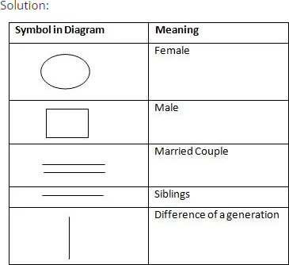
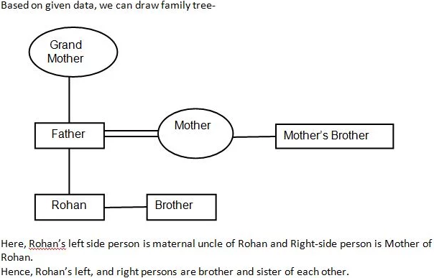
PROBLEM 7:ANSWER

Slide 12
PROBLEM 8:
John introduces Maya as the daughter of the only son of my father’s wife. How is Maya related to John?
A) Mother
B) Daughter
C) Sister
D) Niece
E) Cousin
ANS:B
Notes:
Answer- 2) Daughter

Slide 13
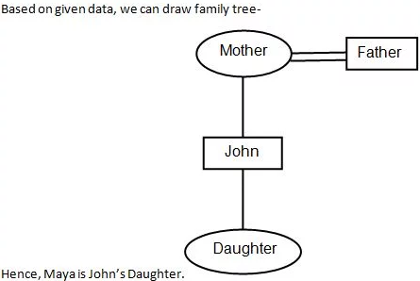
PROBLEM 8:ANSWER
Notes:
Answer- 2) Daughter

Slide 14
PROBLEM 9:
Hitesh said to Nitin, “The girl playing with the football is the younger of the two sisters of the son of my mother’s husband.” How is the girl playing football related to Hitesh?
A) Cousin
B) Sister
C) Daughter
D) Sister-in-law
E) Mother
ANS:B
Notes:
Answer- 2) Sister

Slide 15
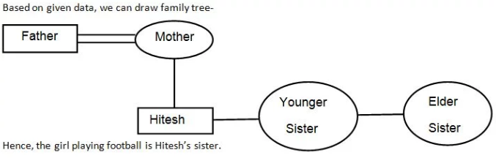
PROBLEM 9:ANSWER
Notes:
Answer- 2) Sister

Slide 16
PROBLEM 10:
Mohan pointing to a girl in the photograph and said, “She is the daughter of the father of the sister of my brother.” How is that girl related to Mohan?
A) Sister
B) Wife
C) Mother
D) Aunt
E) Daughter
ANS:A
Notes:
Answer- 1) Sister.

Slide 17
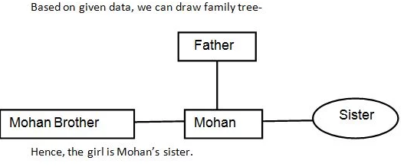
PROBLEM 10:ANSWER
Notes:
Answer- 1) Sister.

Slide 18
PROBLEM 11:
A girl introduced a boy as the son of the daughter of the father of her uncle. The boy is
A. Brother
B. Brother-in-law
C. Son
D. Uncle
E. Son-in-law
ANS:A
Notes:
Answer: A .Brother Justification: Daughter of uncle’s father — Uncle’s sister — Mother; Mother’s son — Brother.

Slide 19
PROBLEM 12:
Pointing to a gentleman, Deepak said, ” His only brother is the father of my daughter`s father.” How is the gentleman related to Deepak ?
A. Grandfather
B. Father
C. Brother-in-law
D. Uncle
ANS:D
Notes:
AnswerD .Uncle Justification: Father of Deepak’s daughter’s father — Deepak’s father. So, the man’s brother is Deepak’s father or the man is the brother of Deepak’s father i.e., Deepak’s uncle.

Slide 20
PROBLEM 13:
If Kamal says, “Ravi`s mother is the only daughter of my mother”, how is Kamal related to Ravi ?
A. Grandfather
B. Father
C. Brother
D. Maternal uncle
ANS:D
Notes:
Justification: Only daughter of Kamal’s mother — Kamal’s sister. So, Ravi’s mother is Kamal’s sister or Kamal is the brother of Ravi’s mother i.e., Ravi’s maternal uncle.

Slide 21
PROBLEM 14:
When Anuj saw Manish, he recalled, “He is the son of the father of my daughter. "Who is Manish ?
A. Brother-in-law
B. Brother
C. Cousin
D. Uncle
ANS:C
Notes:
Justification: Anuj’s daughter’s mother — Anuj’s wife; Anuj’s wife’s father — Anuj’s father-in-law; Father-in-law’s son — Anuj’s brother-in-law. So, Manish is Anuj’s brother-in-law.

Slide 22
PROBLEM 15:
Pointing to a photograph, a woman says, “This man`s son`s sister is my mother-in-law.” How is the woman`s husband related to the man in the photograph?
A. Grandson
B. Son
C. Son-in-law
D. Nephew
ANS:A
Notes:
Justification: Man’s son’s sister — Man’s daughter. So, the man’s daughter is the mother of the woman’s husband. Thus, the woman’s husband is the grandson of the man in the photograph.

Slide 23
PROBLEM 16:
Pointing to an old man, Kailash said, “His son is my son`s uncle”. How is the old man related to Kailash ?
A. Brother
B. Uncle
C. Father
D. Father In Law
E. Grandfather
ANS:C
Notes:
Justification: Kailash’s son’s uncle — Kailash’s brother. So, the old man’s son is Kailash’s brother i.e., the old man is Kailash’s father.

Slide 24
PROBLEM 17:
If (i) M is brother of N; (ii) B is brother of N; (iii) M is brother of D, then which of the following statements is definitely true ?
A. N is brother of B
B. N is brother of D
C. M is brother of B
D. D is brother of M
ANS:C
Notes:
Justification: M is the brother of N and B is the brother of N. So, M is the brother of B.

Slide 25
PROBLEM 18:
A is B`s sister. C is B`s mother. D is C`s father. E is D`s mother. Then, how is A related to D ?
A. Grandmother
B. Grandfather
C. Daughter
D. Grand daughter
ANS:D
Notes:
Justification: A is the sister of B and B is the daughter of C. So, A is the daughter of C. Also, D is the father of C. So, A is the grand daughter of D.

Slide 26
PROBLEM 19:
Pointing to a photograph, a lady tells Pramod, "I am the only daughter of this lady and her son is your maternal uncle." How is the speaker related to Pramod's father
A. Sister-in-law
B. Wife
C. Either (a) or (b)
D. Neither (a) nor (b)
ANS:B
Notes:
Explanation: Clearly, the speaker's brother is Pramod's maternal uncle. So, the speaker is Pramod's mother or his father's wife

Slide 27
PROBLEM 20:
Pointing to a photograph, A says to B, the girl in the photo is the second daughter of his wife of the only son of the grandmother of my young sister. How is the girl related to A?
A)sister
B)niece
C)cousin
D)Both 1&3
ANS:D
Notes:
Answer: d)
Explanation: A had a grandmother, that grandmother son is the father of the girl in the photo cousin.
If A is the paternal grandmother then she is a sister of A.

